Slide 1

University Timetable Using Genetic Algorithm
Loo Hen shen b032010149 biti s1g2
Supervisor: Professor madya ts. Dr. zeratul izzah binti mohd yusoh
Evaluator: professor dr. azah Kamilah binti draman

Slide 2
Problem Statement
Objective
The existing university timetable can be improved.
Traditional timetable-making procedures such as rule-based approach.
Using manual or paper works.
To formulate an optimal university timetable
To implement genetic algorithm in creating a timetable.
To develop a website-based system to generate timetable.
Problem statement & objective

Slide 3
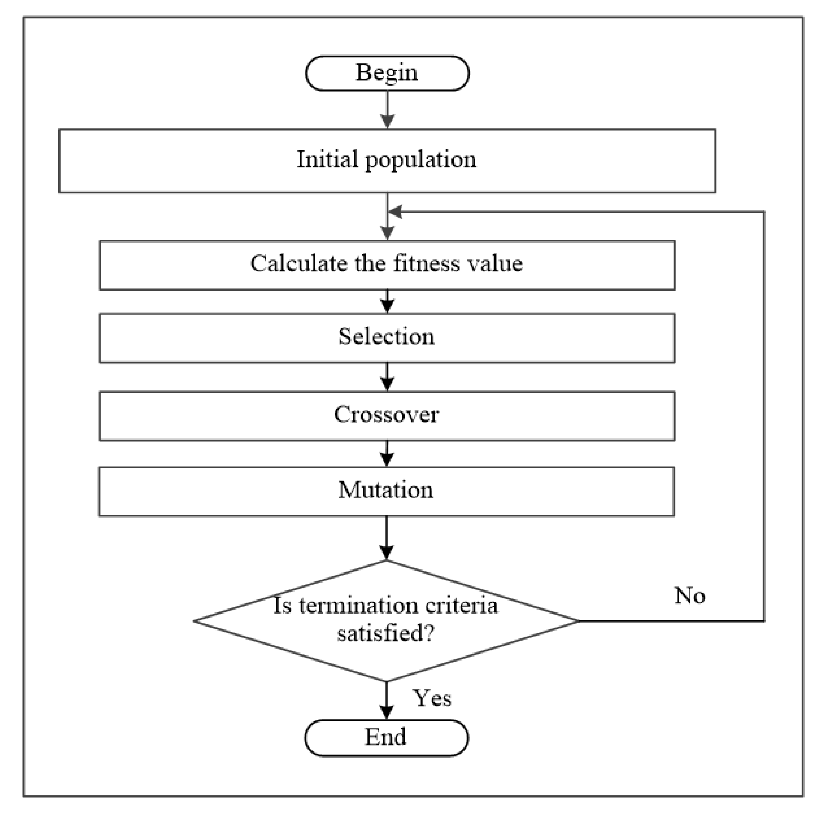
It begins by initializing 550 population of potential solutions (timetables) with random gene values (lecturers, rooms, days & times). Each individual in the population represents a possible timetable.
Each individual is represented as 92 list of classes with genes value of day, hour, consecutive hour, gid, class type, course name, room id, lecturer name, year, program, student batch.
Individual 1: {“Friday”, 11, 12, 7, “Lecture”, “Evolutionary Computing”, “BK1”, “Dr Zeratul”, 2, “BITI”, “S1G1”}, …..(90 classes)….. , {“Monday”, 9, 10, 4, “Lab”, “Artificial Intelligence”, “AI3”, “Dr Elle”, 1, “BITI”, “S1G1”}
Genetic algorithm
Step 1: Initialize the population

Slide 4
The fitness evaluation calculates the fitness of each individual in the population.
It considers both hard and soft constraints related to room assignments, class groups, lecturers, and other factors.
The fitness is a value between 0 and 1, where higher values indicate better solutions.
Genetic algorithm
Step 2: evolutionary loop

Slide 5
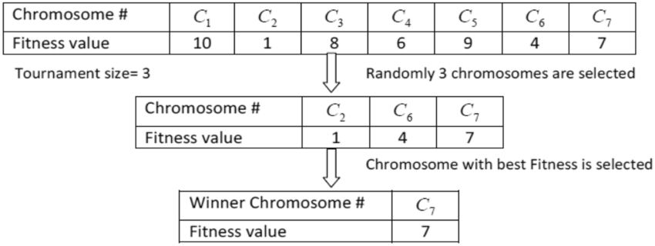
Genetic algorithm
Step 2: evolutionary loop

Slide 6
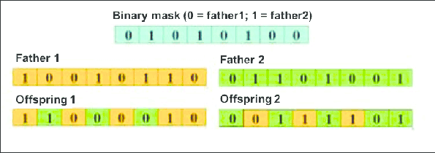
Genetic algorithm
Step 2: evolutionary loop

Slide 7
Genetic algorithm
Step 2: evolutionary loop

Slide 8
The fitness of the offspring is evaluated using the same fitness evaluation as in step 2.
The survival selection combines the current population and offspring.
It selects a new population of numbers of individuals with the highest fitness scores.
The algorithm continues for a 100 generations. It terminates after this number is reached.
Genetic algorithm
Step 3: return the best solution

Slide 9
Hard Constraints: Must be satisfied without exception, such as room availability and lecturer conflicts. Soft Constraints: Allow trade-offs and optimizations to improve solution quality.
Fitness Evaluation

Slide 10
Hard Constraints Room Assignment Constraint: Ensure that a room is not assigned on the same day and hour
Fitness Evaluation

Slide 11
Hard Constraints No Class During Certain Hour Constraint: Ensure that a class is not assigned during certain hour
Fitness Evaluation

Slide 12
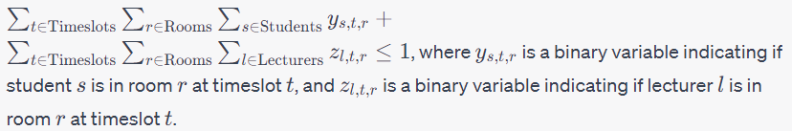
Hard Constraints Student-Lecturer Clash Constraint: Ensure that students and lecturers are not assigned at the same time
Fitness Evaluation

Slide 13
Hard Constraints Room Type Compatibility Constraint: Ensure that a class is assigned to a room with a compatible type
Fitness Evaluation

Slide 14
Hard Constraints Qualified Lecturer Constraint: Ensure that a class is assigned by a qualified lecturer
Fitness Evaluation

Slide 15
Soft Constraint Preferred Lecturer Constraint: Encourage assigning a class to a preferred lecturer
Fitness Evaluation

Slide 16
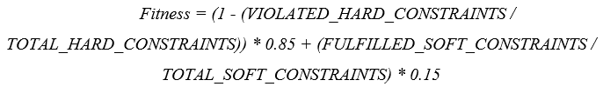
Fitness Score Calculation Fitness Score:
Fitness Evaluation

Slide 17
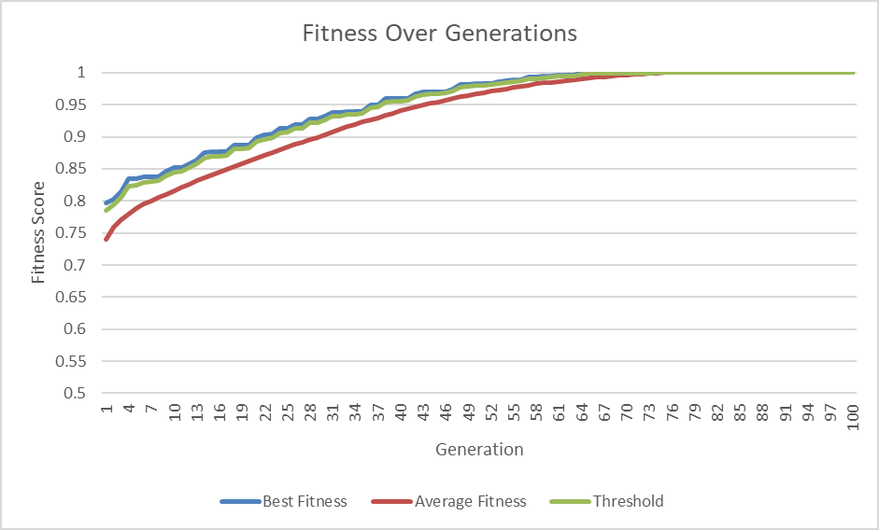
Testing 1: Population Size 550
Fitness Evaluation

Slide 18
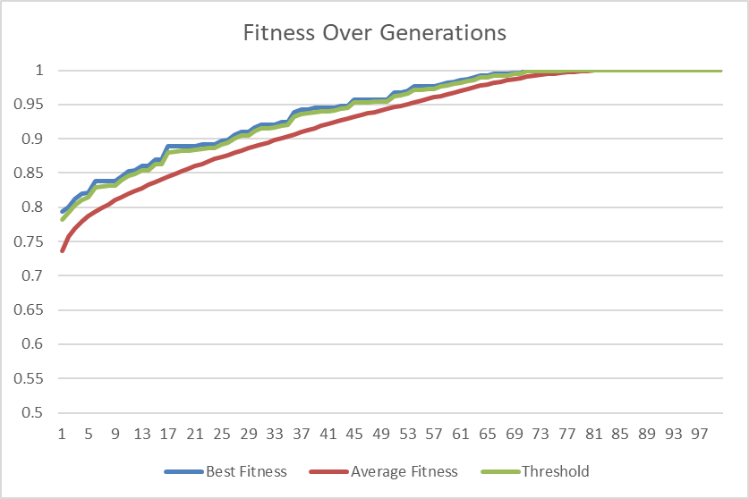
Testing 2 : Population Size 550
Fitness Evaluation

Slide 19
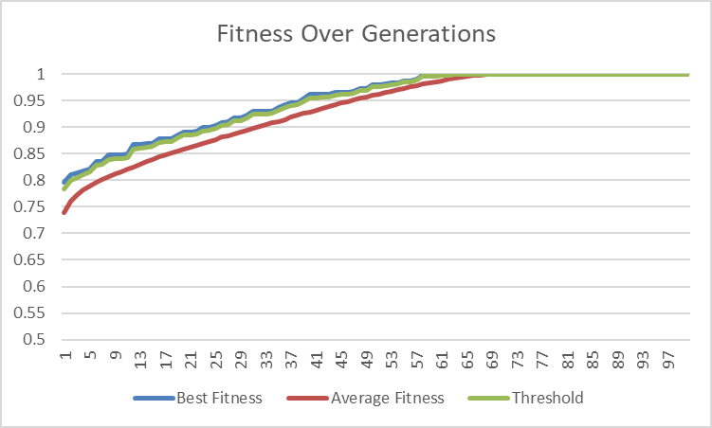
Testing 3 : Population Size 550
Fitness Evaluation

Slide 20
Runs | Best Fitness | Average Fitness | Time Taken
1 | 1 | 1 | 5.716666666
2 | 1 | 1 | 5.666666666
3 | 1 | 1 | 5.933333333
Min | 1 | 1 | 5.666666666
Max | 1 | 1 | 5.9333333333
Average | 1 | 1 | 5.772222222
Standard Deviation | 0 | 0 | 0.115737037
Algorithm performance

Slide 21
timetable 1.pdf timetable 2.pdf timetable 3.pdf
Final output

Slide 22
Strengths
Weaknesses
Utilizes genetic algorithm to search through a large solution space to find optimal timetables.
Reduces the need for manual timetable generation.
Enables data storage and retrieval capabilities.
The system's performance and responsiveness may degrade as data volume increases.
Conclusion

